Slide 1
Senior Design Project
ECEN 403 White Paper

Slide 2
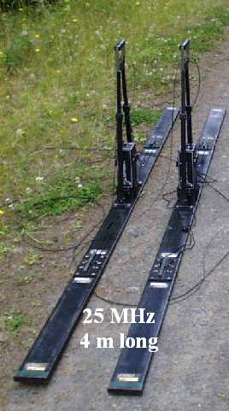
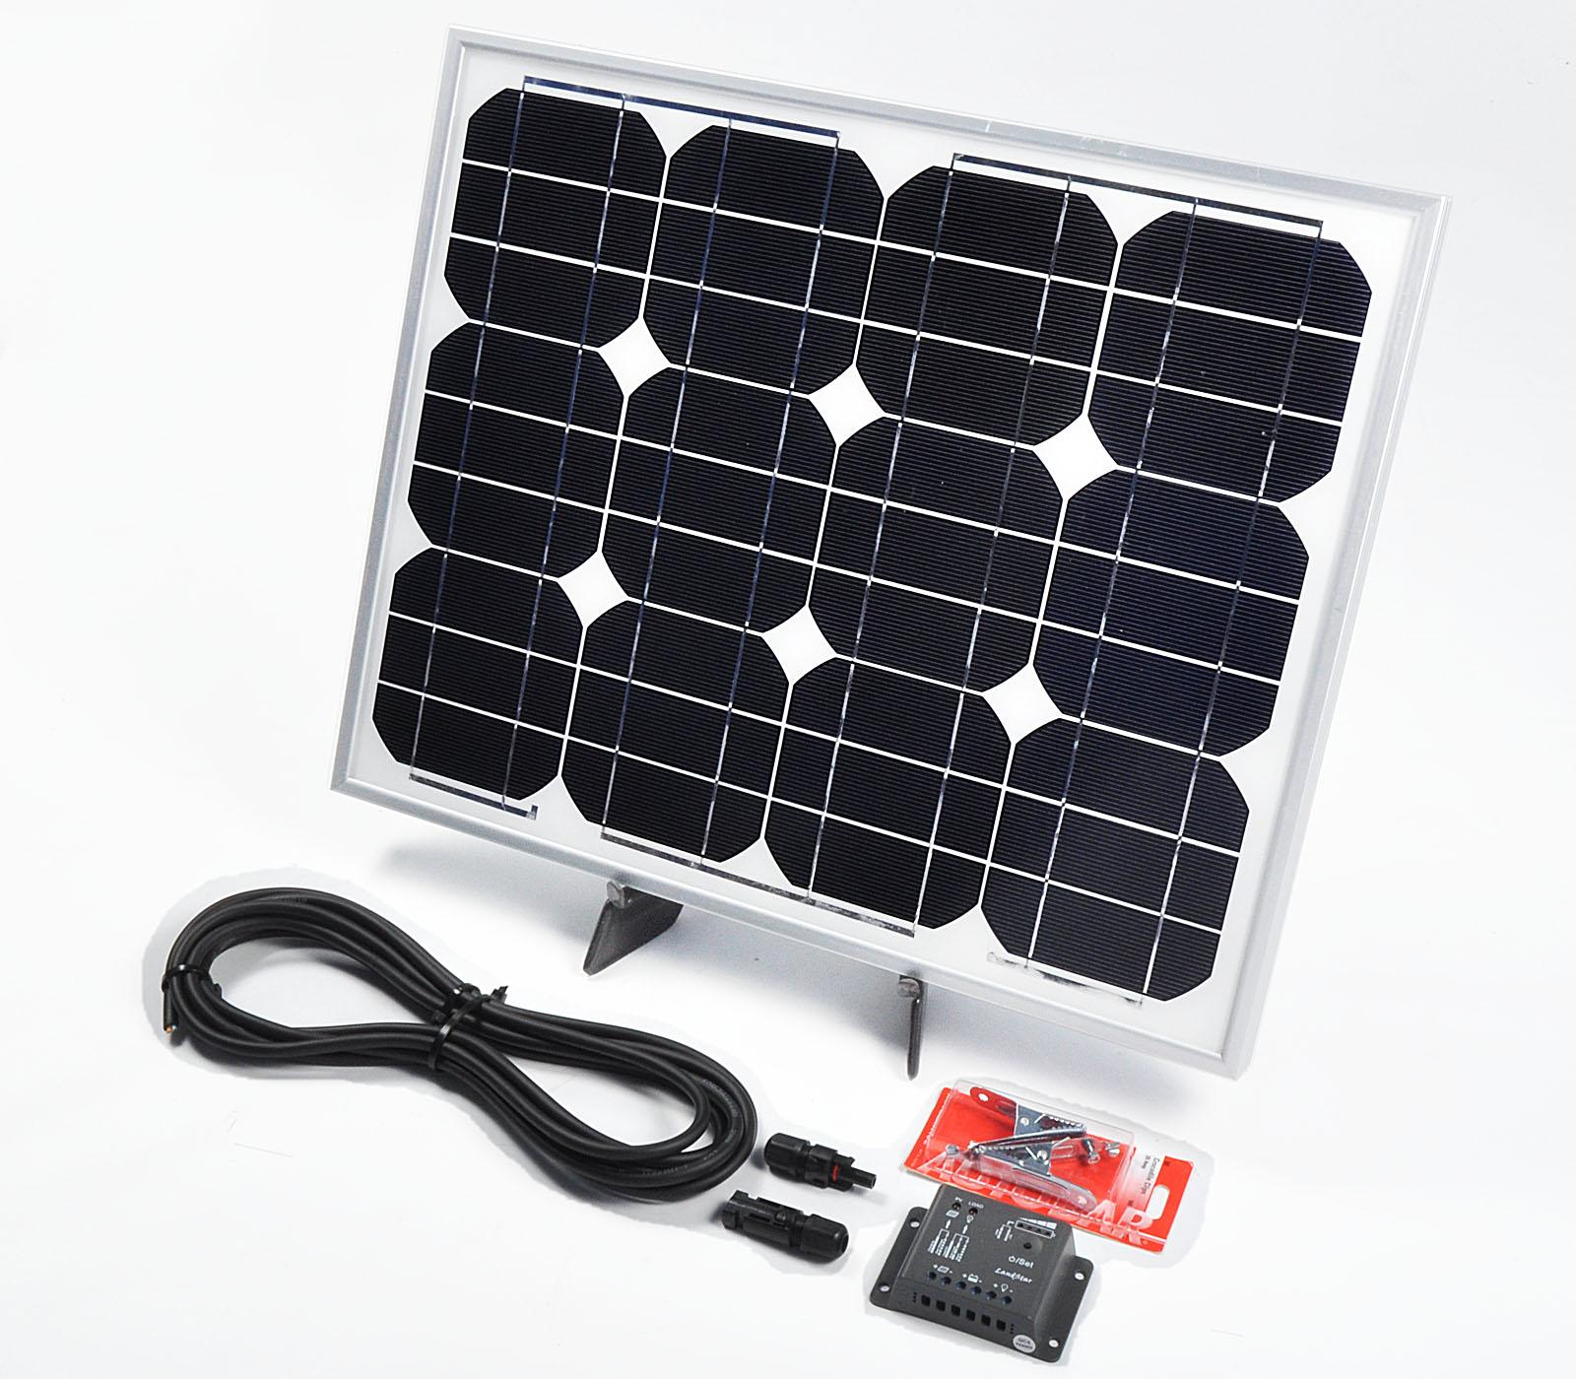
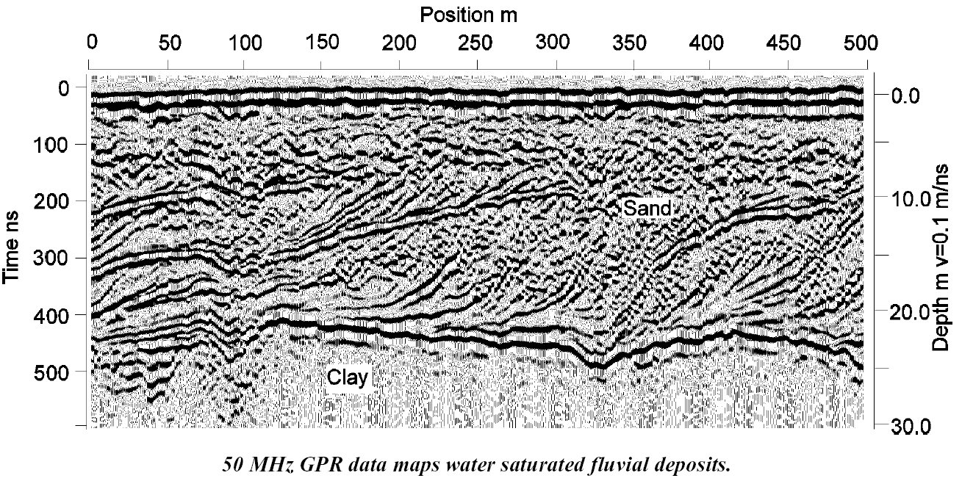
Remote Ground Penetrating Radar System with Recharging Station

Slide 3
Subterranean Mapping with Ground Penetrating Radar
Team 12- Matthan Myers, Cameron Chollett, Blade Roybal, Lotanna Agbasi
Power/
Power/
Recharging
Recharging
Power/
Project Goals: Modify a RC vehicle to be capable of radar imaging of aerial mapping of terrain. This device would be beneficial in the agricultural sector where a root system could be scanned without having to excavate the site.
Project Deliverables: A RC vehicle equipped with a modular Radar system, a NUC for data offloading and visualization, backscatter processing for GPR imaging, smart recharge station and power distribution for antennas.
Power/ Recharging
Radar/RF Design/ Circuit Design
Data Collection
Image Processing

Slide 4
Sub-System Team Matrix
Subsystem | Team Member | Student Tasks
Data Collection/ Visualization | Mattahn Myers | Design and implement a database and nuke so that backscatter information can be uploaded and saved, and utilize visualization such that this data can be turned into a comprehensible map
Image Processing | Cameron Chollett | Design a software based component that will filter and alter an input signal to create a GPR image. The backscatter data will be amplified and modulated before it is collected.
Radar/RF Design/ Circuit Design | Blade Roybal | Design an antenna to convert signal voltage to a transmitted EM wave use to transmit a time-varying microwave. Integrate antenna into overall radar design with transmitters, receivers, and amplifiers. Build an appropriate transmission line circuit.
Power/ Recharging | Lotanna Agbasi | Design and implement an efficient way of powering ground vehicle through alternative sources such as solar energy

Slide 5
RF Design Subsystem
Functional Requirements:
The antenna system must be able to provide a pulse of radio frequencies at a range of frequencies capable of penetrating earth to map the root systems of trees
Design Parameters:
The subsystem design must be light and modular enough to be carried by a remote controlled vehicle. The antennas must be capable of penetrating at least 1m beneath the surface and return polarimetric signals.
Primary Constraints:
Provide an ultra wide bandwidth pulse in the range of 300MHz to 3GHz. The data generated must be readable by the backscatter processing subsystem.
Limiting Factors:
The physical size and weight of the antennas to withstand such a wide range of pulses, the cost of the subsystem to be built, and the processing power to store enough data quickly of the onboard computer.

Slide 6
Comparison of Strategies
Method of Mapping Trait - Priority Multiplier (Max Pts.) | Ground Penetrating (GPR) | Synthetic Aperture (SAR) | Ground Penetrating (GPR) From an Aerial Vehicle
Operating Frequency - 2 (Max Pts. 10) | 5*2=10 | 2*2=4 | 4*2=8
Weight - 1 (Max Pts. 5) | 2 | 4 | 1
Image Quality - 1 (Max Pts. 5) | 3 | 4 | 2
Range - 2 (Max Pts. 10) | 4*2=8 | 2*2=4 | 3*2=6
Total (Out of 30) | 25 | 16 | 17

Slide 7
Implementation with Technical Justification
We decided that the best route concerning antennas would be to use a Ground Penetrating Radar (GPR) system attached to a remote controlled vehicle with enough torque to pull the system across the ground. Synthetic Aperture Radar (SAR) would produce a much clearer image with the use of smaller antennas but lacks the capability of penetrating the earth. The primary target is to design a system to map root systems, so no penetration capabilities will not work. The justification for choosing a ground vehicle vs. and aerial vehicle for GPR is derived from the fact that a horn antenna capable of an ultra-wide bandwidth pulse of 300MHz to 1GHz weighs roughly 25 pounds. No quadcopter system available for purchase at a reasonable price can hold such a large weight with the addition of additional hardware like the Intel NUC. The decision to have this subsystem pulled across the ground allows us to also experiment with different antenna designs that can produce better results and will allow the max range of the UWB pulse to penetrate upwards of 3 meters.

Slide 8
Image Processing Subsystem
Functional Requirements:
The image processing software, using a set of input data points, will create a matrix for the sampled area and will produce a 3D image of the objects underground.
Design Parameters:
The software must be capable of image processing, even if modules or more software must be downloaded to aide in the process.
Primary Constraints:
The software must be able to load in data points from a server, and it must be compatible with all forms of operating systems, most importantly windows.
Limiting Factor:
Possible issues could occur in the software’s processing capabilities, if a team member is not familiar with the software, or if the software coding is too difficult to apply to the scope of the project. All of these would lead to more time spent learning the software, as well as more time spent debugging and testing the code.

Slide 9
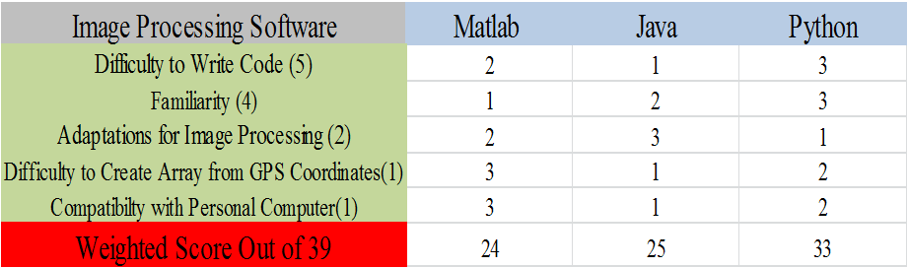
Weighted Decision Matrix

Slide 10
Technical Justification
We decided to use Python as our primary image processing software. The main factors that contributed to this decision were that Python is a very simple coding language that is easy to understand and easy to write, and everyone on the team has experience using it. Although downloading the image processing modules for Python is not easy and sometimes has compatibility issues, we found that this problem would not be hard to fix. We almost decided to use matlab, but the difficulty of writing code was a large enough problem to persuade the group to use a different software. The main problem with Java was the difficulty of writing code and the number of people in the group that had experience using it.

Slide 11
Data Collection Subsystem
Functional Requirements:
The data collection subsystem will take in measured data from the radar unit/antennas and store it in a relational database located on a server.
Design Parameters:
The subsystem will store the data locally on the RC vehicle and then transfer the data to the server when it’s at the home base.
Primary Constraints:
A small computing unit must be placed aboard the RC vehicle in order to store the data and upload at docking time.
Limiting Factors:
The computing unit placed aboard the RC vehicle must be lightweight such that it does not prohibit the RC vehicle from flying. It must not be power intensive if it is to be run while aboard the RC vehicle as well.

Slide 12
Weighted Decision Matrix
Method of storage/upload | Upload During (Over Time/Cellular) | Upload After (All At Once/Bluetooth) | Process During (Image Processing Onboard)
Power Consumption - 2 (Max Pts. 4) | 2 | 3 | 1
Weight - 1 (Max Pts. 10) | 8 | 8 | 4
Reliability/Practical Design - 3 (Max Pts. 8) | 5 | 8 | 4
Total (Out of 22) | 15 | 19 | 6

Slide 13
Technical Justification
Due to the constraints of our project and design, we decided that uploading our data to the server all at once was the best option given that it was the least power hungry, lightest, and most practical option available. We also knew that computers are all generally fragile and don’t do well with outside elements, so we didn’t add durability into the equation.
Adding an onboard unit capable of doing all of the processing would not only consume lots of power, but would also have to be beefy enough to handle this processing, which would mean more weight, something we can’t afford on such a small vehicle. This option was by far the most impractical.
The option that came in second was uploading the data to a server via cellular service as the RC vehicle went. The biggest problems with this were (a) the amount of data cellular service can transmit at once, as this is raw data that hasn’t been trimmed yet, and (b) the amount of power it would take to transmit said data, since using antennas generally is a large source of consumption.
The option we decided on was the most elegant and lightweight. It essentially minimizes what is done on the RC vehicle and leaves the heavy lifting to the server, which is optimal, since power is not a constraint for the server.

Slide 14
Power/ Recharging Subsystem
Functional Requirements: Provide power to the ground vehicle
Design Parameters: Converts sunlight to a constant DC voltage which is then fed to the battery.
Primary Constraints: Deliver constant voltage of ~12V to ground vehicle battery.
Limiting Factors: Size of the system (should be portable), time to design and build, durability (must be able to function in a predictable manner in any given weather condition

Slide 15
Mono-, Polycrystalline, and Thin film are all various types of solar panels.
Cost is deemed the most important, due to the budget and wide gap between the types of panels while time is the least important factor, because it will be the same regardless of which solar panel is implemented.
Power Subsystem | Monocrystalline | Polycrystalline | Thin Film
Cost- 10 point max (1- most important) | 5 | 8 | 10
Durability- 6 points max (3) | 3 | 3 | 6
Efficiency- 8 points max (2) | 8 | 5 | 3
Time- 4 points max (4- least important) | 4 | 4 | 4
Total (out of 28) | 20 | 20 | 23

Slide 16
Technical Justification
With the aid of the weighted decision matrix it was decided that a thin film solar panel would be the most effective for this current application.
By far the cheapest of the three options, the thin film will not eat into the project budget as compared to the monocrystalline or polycrystalline.
The mono- and poly- solar panels also are not very durable. Covering due to shade, dirt, or any kind of precipitation can greatly affect and damage the internal circuitry or a mono- or poly- solar panel, while the thin film is more durable in these conditions, ensuring predictable behavior, and ultimately making it more preferable.
While it is the least efficient of the three choices (~10%, as compared to ~18% for mono-), it’s cost and durability make it the panel of choice.

Slide 17
Sub-system Task Matrix
Subsystem | Subsystem Task | Needs
Data Collection/ Visualization | Create a database system and turn data into visual “map” | Quadcopter must be able to store all backscatter data before uploading, once docked/plugged in all data must transfer at once, visualized data must be something that is easy to understand
Backscatter/ Processing | Design a system to receive and handle the backscatter. Create a program that will process the backscatter to display an image of the elevation of the land. | A RF modulator and signal amplifier to better store the backscatter data. Program using C++ coding for data processing, filtering, and image formation.
Radar/RF Design/ Circuit Design | Build a Modular Radar Sensor capable of measuring range and receiving data capable of forming Synthetic Aperture radar (SAR) images. | A transmitter, receiver, Two port RF components, amplifier, mixer, antenna, and splitter.
Power/ Recharging | Re-charge battery of the ground vehicle | Power source needs to be stationary, sturdy, durable in even less than desirable weather. Must be able to provide constant 12V DC to battery for re-charge.

